Slide 1
Crop Type Detection Project

Slide 2
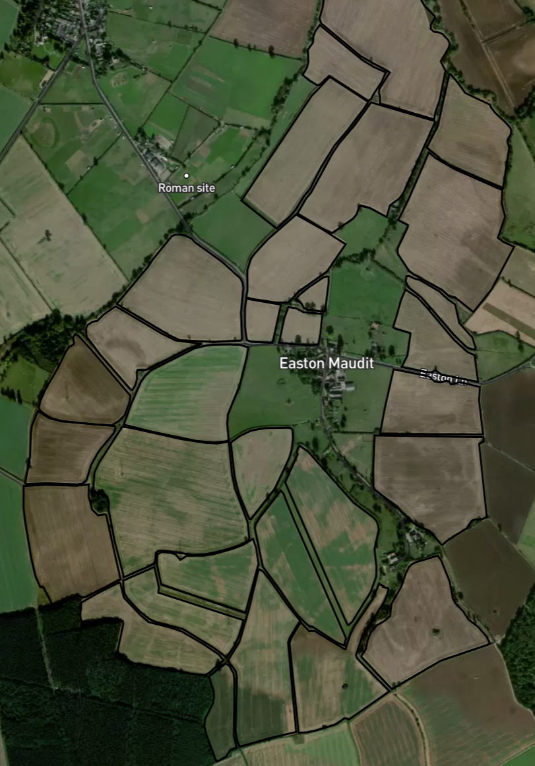
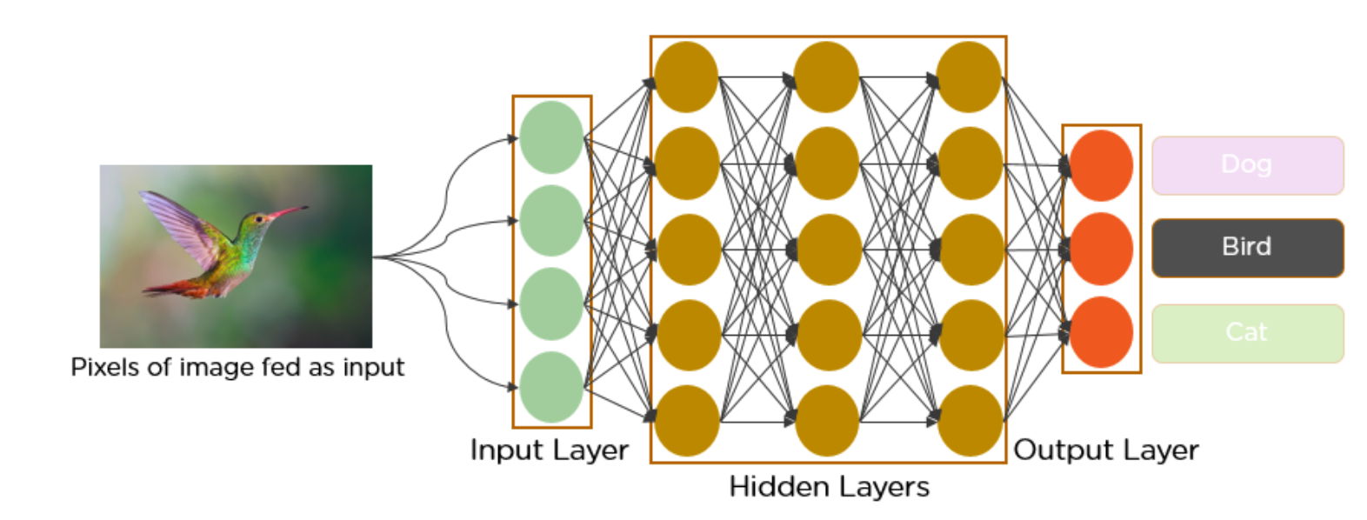
Convolutional Neural Networks (CNN)
- A Deep Learning algorithm
- Require much lower pre-processing compared to other classification algorithms
- Take images as inputs
- Assign importance to various objects in the images to differentiate one from the other

Slide 3
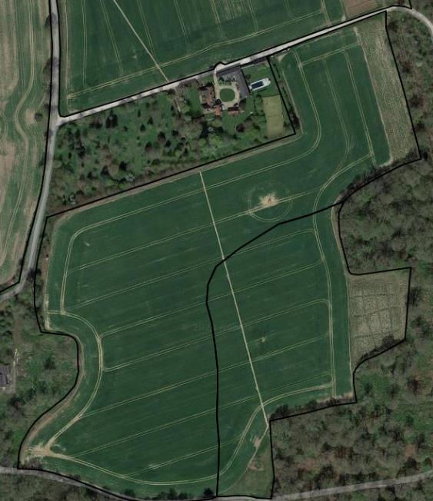
Model Evaluation Metrics
Accuracy:
Measure the percentage of correct predictions of the model
Loss:
Imply how poorly a model behaves in each training iteration (need to be reduced)
Year 1
Year 2
Wheat
OSR
Wheat

Slide 4
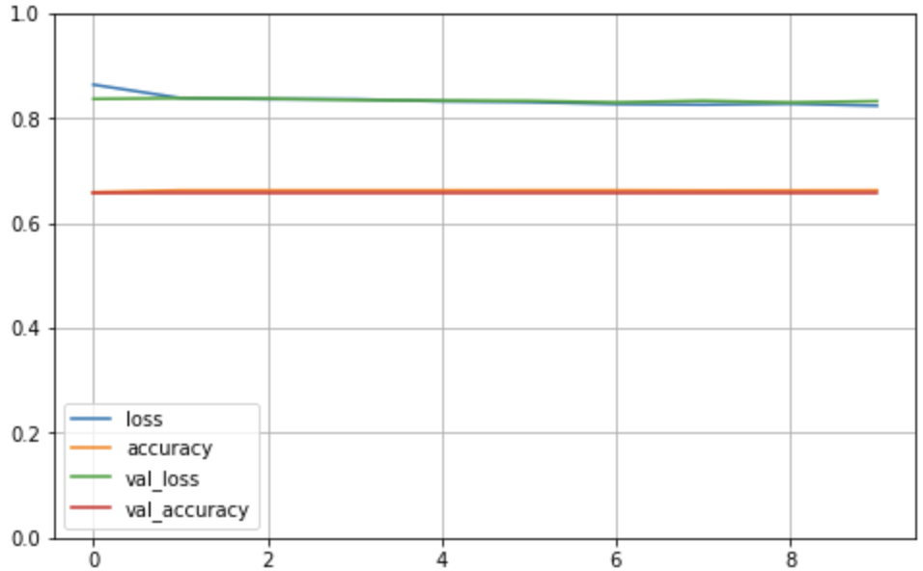
Sequential CNN Model
One input layer, one output layer, and twelve hidden layers
551,043 parameters

Slide 5
Sequential CNN Model
- Problem 1: Vanishing Gradients
Some neurons can “die” in the training and become ineffective, so this can cause high information loss.
- Problem 2: Optimization Difficulty
If parameters increase due to increasing depth (more layers), training the network becomes very difficult.

Slide 6
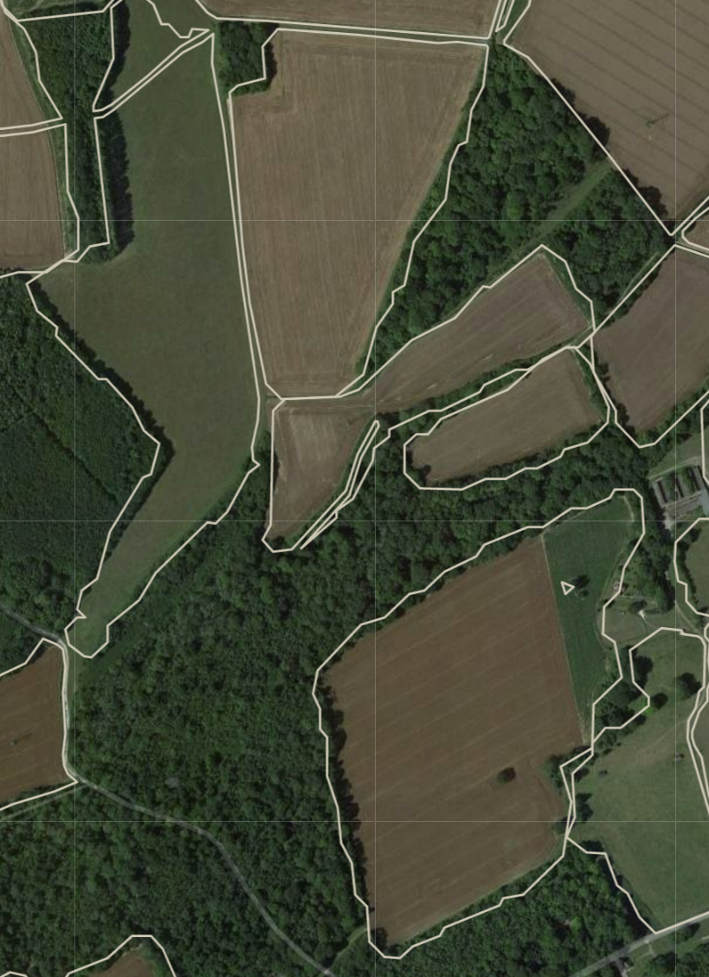
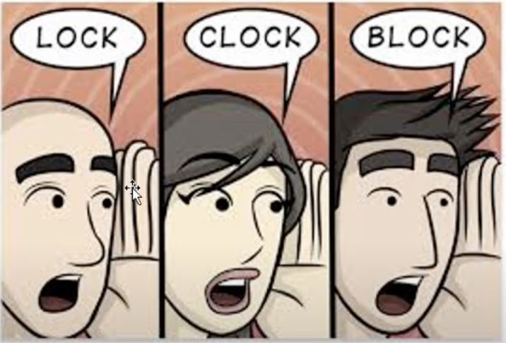
ResNet Deep Learning Architecture

Slide 7
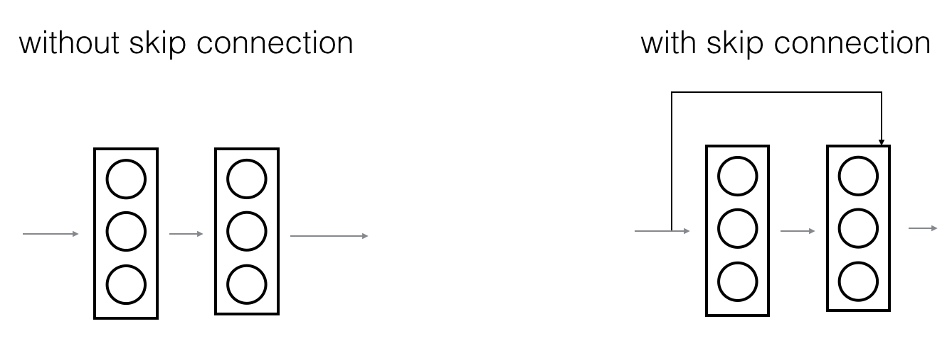
ResNet Deep Learning Architecture
ResNet first introduced the concept of “skip connection”
Fasten the training of the model
Prevent information loss and errors

Slide 8
Spilt Data Sets
For each data set, we spilt it into train set, validation set and test set:
Train set: The largest part on the data set (70%)
We trained over model based on the train set to “learn” information of images
Validation set: The ‘test set’ in the training progress
To get a sense of how well the model is doing on images that were not used in training
Test set: An ‘independent’ dataset that model did not see before
We can use test set to get the unbiased evaluation of our model
Year 1
Year 2
Wheat
OSR
Wheat

Slide 9
Three Preprocessed Data Sets
Data Set I: 3 Crop Types 16893 instances
Barley (Spring), Wheat (Spring), and Oats (Spring)
- Data Set II: 6 Crop Types 18275 instances
Barley (Spring), Grass, Oilseed rape (winter), Uncropped land,
Forage Maize, Beans
Data Set III: Augmented Train Set 23279 instances
7 Crop Types (contains two very similar crop types)
Barley (Spring), Barley (Winter), Grass, Oilseed rape (winter), Uncropped land, Forage Maize, Beans
Year 1
Year 2
Wheat
OSR
Wheat

Slide 10
ResNet Model for Data Set I
Three Crop Types (relative imbalanced data):
The number of instances for each crop type:
Barley (spring): 11199
Wheat (spring): 4261
Oats (spring): 1433
Overall accuracy on test set: 96.14%
Accuracy for each crop type:
Accuracy for class Barley (spring) is: 98.42%
Accuracy for class Wheat (spring) is: 94.86%
Accuracy for class Oats (spring) is: 81.39%
Year 1
Year 2
Wheat
OSR
Wheat

Slide 11
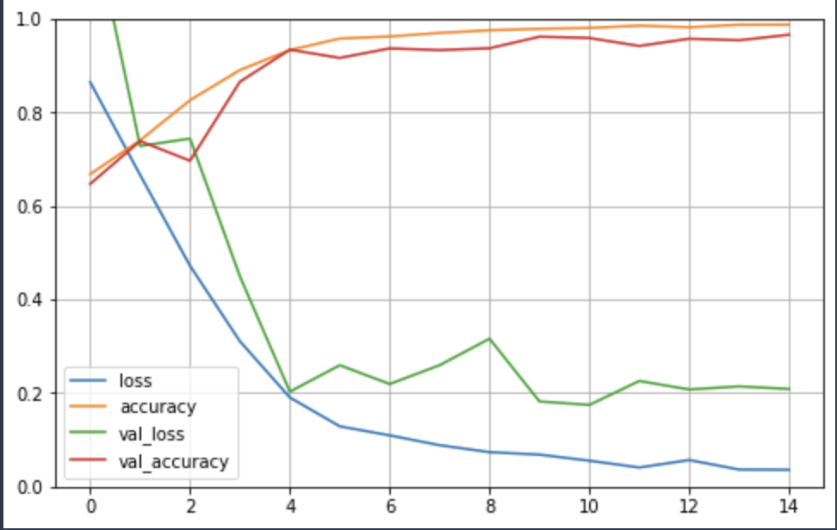
ResNet Model for Data Set I
Training History:
Year 1
Year 2
Wheat
OSR
Wheat

Slide 12
ResNet Model for Data Set II
Six Crop Types (relative imbalanced data):
The number of instances for each crop type:
Barley (spring): 4959
Grass: 4947
Oilseed rape(winter): 3760
Uncropped land: 1859
Forage Maize: 1464
Beans: 1289
Year 1
Year 2
Wheat
OSR
Wheat

Slide 13
ResNet Model for Data Set II
- Overall accuracy on test set: 80.11%
Accuracy for each crop type:
Accuracy for class Barley (spring) is: 79.90%
Accuracy for class Beans is: 69.17%
Accuracy for class Forage Maize is: 91.03%
Accuracy for class Grass is: 83.69%
Accuracy for class Oilseed rape (winter) is: 76.61%
Accuracy for class Uncropped land is: 77.44%
Year 1
Year 2
Wheat
OSR
Wheat

Slide 14
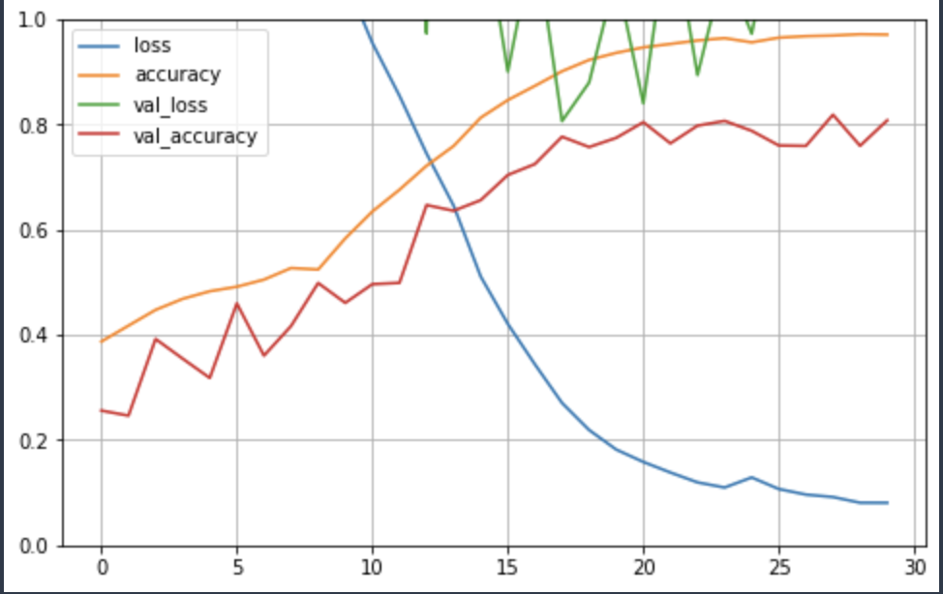
ResNet Model for Data Set II
Training History:
Year 1
Year 2
Wheat
OSR
Wheat

Slide 15
ResNet Model for Data Set III (Augmented Train Set)
Seven Crop Types :
The number of instances for each crop in train set(the test set was not augmented):
Grass: 5000
Oilseed rape (winter): 5000
Barley (Winter): 5000
Barley (spring): 5000
Uncropped land: 3230
Forage Maize: 2837
Beans: 2212
Year 1
Year 2
Wheat
OSR
Wheat

Slide 16
ResNet Model for Data Set III(Augmented Train Set)
- Overall accuracy on training set: 96.23%
Overall accuracy on test set: 74.74%
Accuracy for each crop type:
Accuracy for class Barley (winter) is: 64.51%
Accuracy for class Barley (spring) is: 71.15%
Accuracy for class Beans is: 82.67%
Accuracy for class Forage Maize is: 88.03%
Accuracy for class Grass is: 82.67%
Accuracy for class Oilseed rape (winter) is: 67.45%
Accuracy for class Uncropped land is: 93.04%
Year 1
Year 2
Wheat
OSR
Wheat

Slide 17
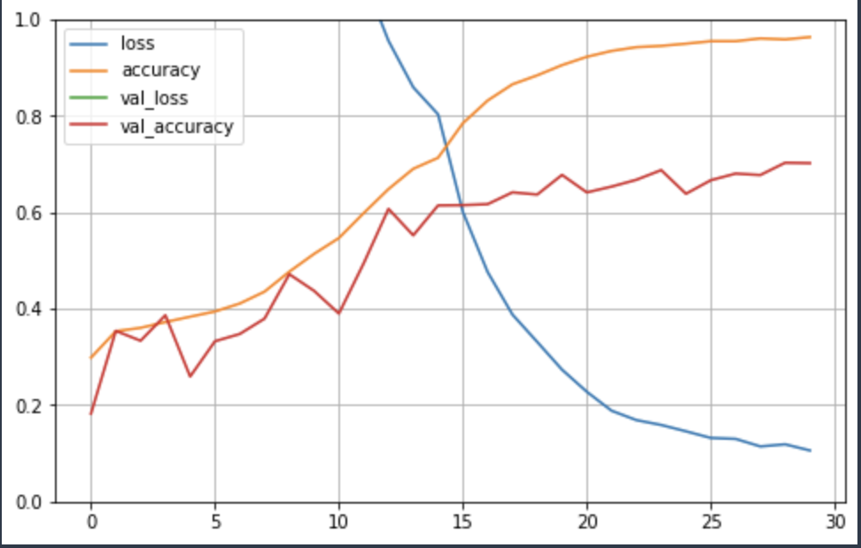
ResNet Model for Data Set III
Training History:
Year 1
Year 2
Wheat
OSR
Wheat

Slide 18
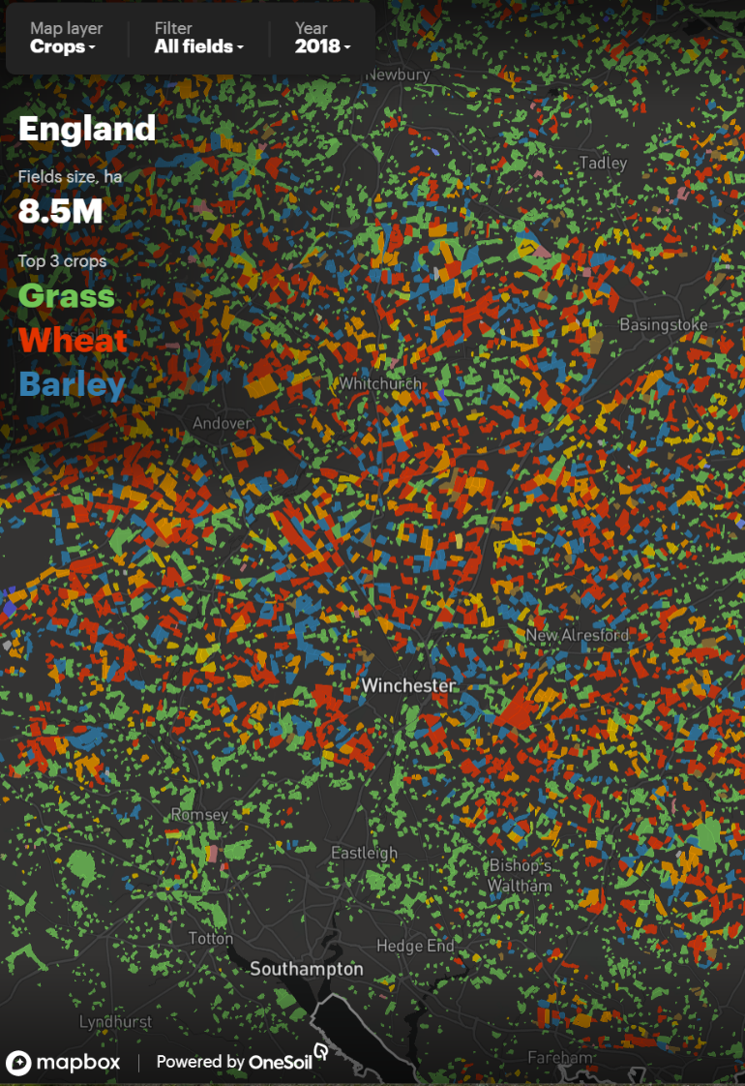
Summary:
Pros:
Short training time (only 40 mins for data set I)
High Accuracy on detecting small number of crop types
Small information loss
Cons:
Relative lower accuracy on detecting large number of crop types
Sensitive to imbalanced data
- Struggling with detecting very similar crops (e.g winter Barley & spring Barley)

Slide 19
Thank you

